Slide 1

Paper 1
Revision Booklet
Name: ___________________

Slide 2
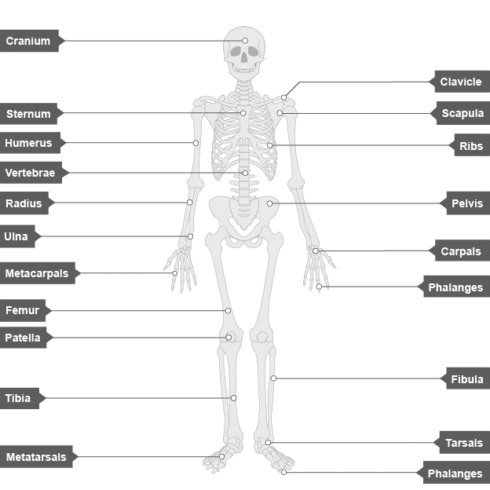
GCSE Skeletal System: What do I need to know?
Know the location of the major bones in the body, know the 6 main functions of the skeleton.
Function | Description

Slide 3
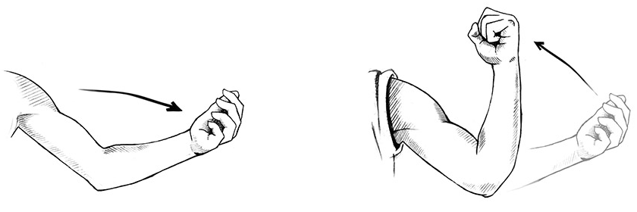
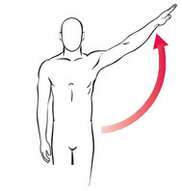
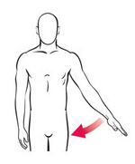
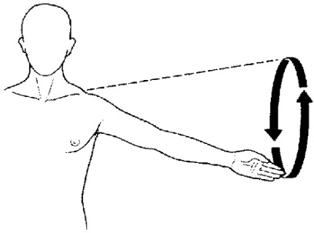
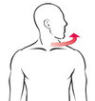
GCSE Skeletal System: What do I need to know?
Know the structure of a synovial joint, know the 6 types of movement, know the two types of joint and the movements available, know the articulating bones of the knee, hip, shoulder and elbow.
A synovial joint is…
Element | Function
Ligaments
Tendons
Cartilage
………………………..
………………………..
………………………..
………………………..
………………………..
………………………..
Joint | Type | Articulating Bones | Movements
Knee
Hip
Elbow
Shoulder

Slide 6
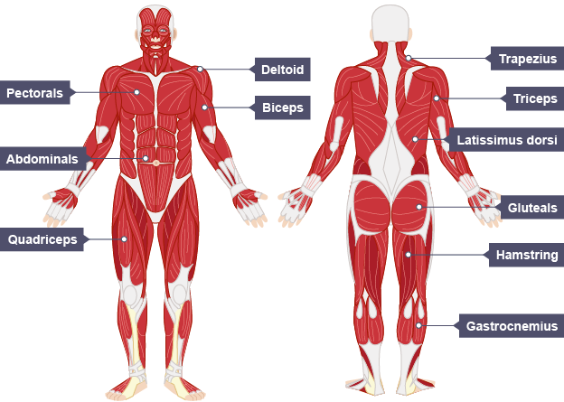
GCSE Muscular System: What do I need to know?
Know the location of the major muscles in the body, know the role of the agonist, antagonist and fixator, know the three main antagonistic pairs
Type | Description
Agonist
Antagonist
Fixator
Joint | Muscle Pair | Movements
Shoulder
Elbow
Knee

Slide 7
GCSE Muscular System: What do I need to know?
Know the movement caused when each muscle is the agonist and give sporting examples.
Muscle | Movement? | At which joint? | Sporting example
Bicep
Tricep
Quadricep
Hamstring
Deltoid
Latissimus Dorsi
Gluteals
Gastrocnemius
Abdominals

Slide 9
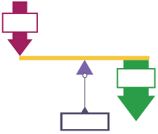
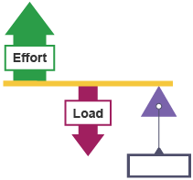
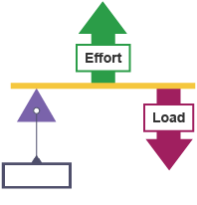
GCSE Levers: What do I need to know?
Know the three classes of lever and their use in sport. Know the definition of mechanical advantage.
Type of Lever _________________________
Where is it found in the body?
Sporting example:
Type of Lever _________________________
Where is it found in the body?
Sporting example:
Type of Lever _________________________
Where is it found in the body?
Sporting example:
Second class levers have a mechanical ____________ because the ________ is closer to the fulcrum than the ________. This means that _________________________________________________________.
Third class levers have a mechanical ____________ because the ________ is closer to the fulcrum than the ________. This means that _________________________________________________________.

Slide 10
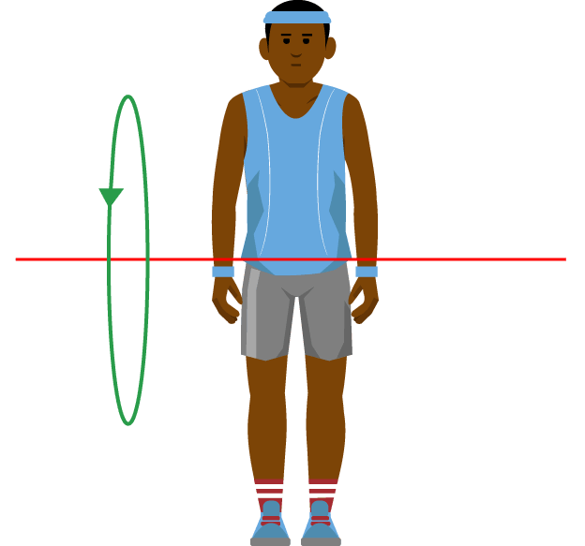
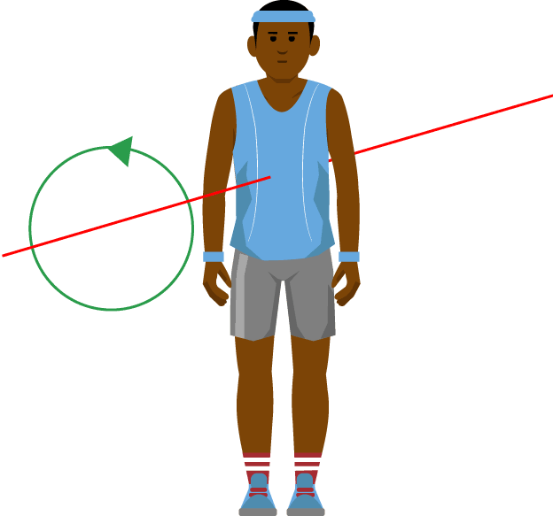
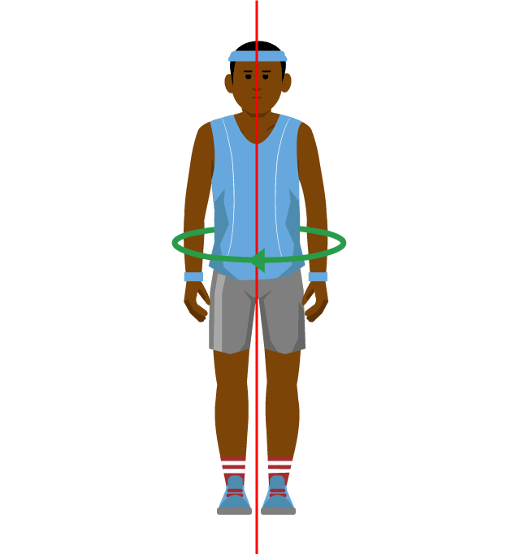
GCSE Planes & Axis: What do I need to know?
Know the location of the planes of movement and application to examples. Know the location of the axis of rotation and application to examples.
Name of Axis _________________________
Description:
Movement example:
Name of Axis _________________________
Description:
Movement example:
Name of Axis _________________________
Description:
Movement example:

Slide 11
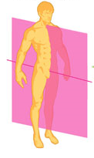
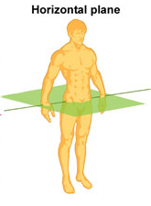
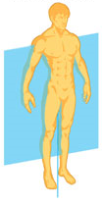
GCSE Planes & Axis: What do I need to know?
Know the location of the planes of movement and application to examples. Know the location of the axis of rotation and application to examples.
Name of Plane _________________________
Description:
Linked Movements:
Linked Axis:
Example:
Name of Plane _________________________
Description:
Linked Movements:
Linked Axis:
Example:
Name of Plane _________________________
Description:
Linked Movements:
Linked Axis:
Example:

Slide 13
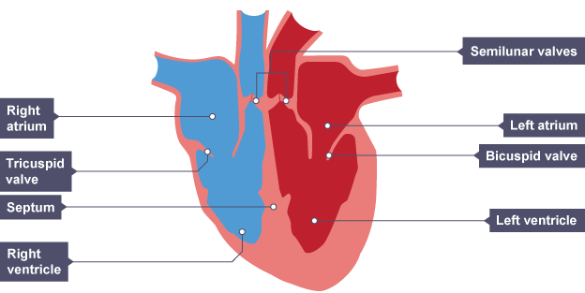
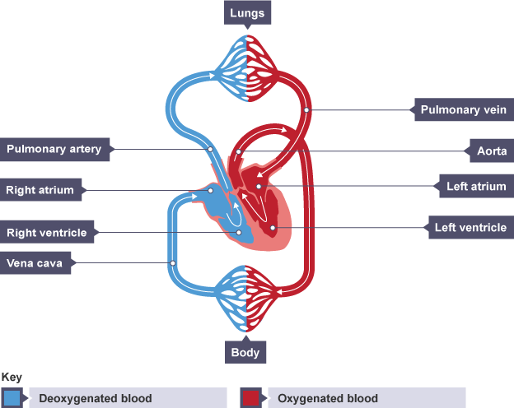
GCSE Cardiovascular System: What do I need to know?
Know the double circulatory system, know the different types of blood vessel, understand the pathway of blood through the heart, know the equation for cardiac output, know the role of red blood cells.
Pulmonary System | Pumps blood from…
Systemic System | Pumps blood from…

Slide 14
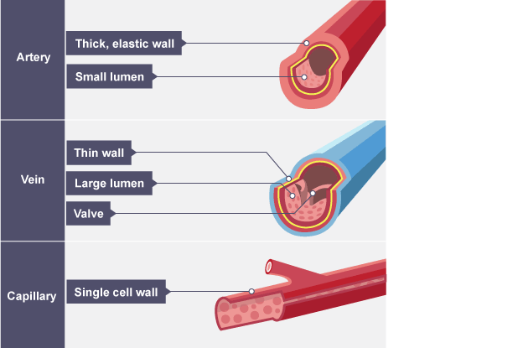
GCSE Cardiovascular System: What do I need to know?
Know the double circulatory system, know the different types of blood vessel, understand the pathway of blood through the heart, know the equation for cardiac output, know the role of red blood cells.
What is the role of a red blood cell?
 | Artery | Vein
Function
Wall
Lumen
Blood travels at high or low pressure?
Cardiac Output equation (including units):

Slide 17
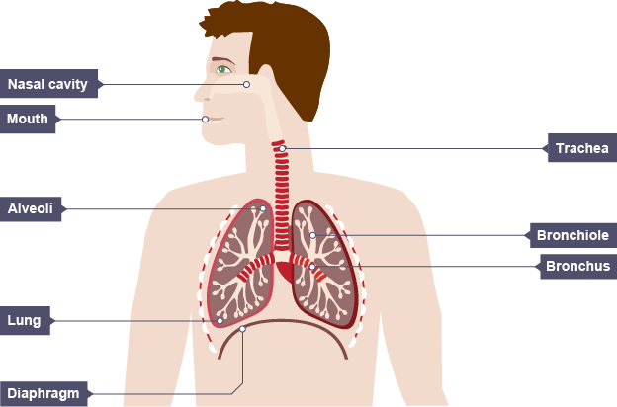
GCSE Respiratory System: What do I need to know?
Understand the pathway of air through the respiratory system, know the role of respiratory muscles in breathing, know the minute ventilation equation, know about alveoli as the site of gaseous exchange.
Minute Ventilation Equation & Units:
Mouth/Nose
Alveoli
 | Inspiration | Expiration
Muscles…
Chest Cavity Size…
Pressure…
Air flows…
During gaseous exchange, oxygen diffuses from…
During gaseous exchange, carbon dioxide diffuses from…

Slide 18
GCSE Aerobic & Anaerobic Exercise: What do I need to know?
Know the definitions of aerobic and anaerobic exercise, be able to apply practical examples.
 | Aerobic | Anaerobic
Definition
Duration of Exercise
Intensity of Exercise
Equation
Sporting Examples

Slide 20
GCSE Effects of Exercise: What do I need to know?
Understand the short term effects of exercise on the body systems, understand the long term effects of exercise on the body systems.
Short Term Effects
Effect | What happens | Why?
Muscle Temperature
HR/SV/Q
Redistribution of blood
TV/VE/BR
Oxygen to muscles
Lactic acid production
Long Term Effects
Effect | What happens | Why?
Bone Density
Muscle Hypertrophy
Muscular Strength
Muscular Endurance
Resistance to Fatigue
Rate of Recovery
Aerobic Capacity
Respiratory Muscles

Slide 22
GCSE Components of Fitness: What do I need to know?
Know the definition, examples of and fitness tests for the components of fitness.
Component | Definition | Examples
Agility
Balance
Coordination
Power
Agility
Reaction Time
Muscular Strength
Muscular Endurance
Cardiovascular Endurance
Speed

Slide 23
GCSE Components of Fitness: What do I need to know?
Know the definition, examples of and fitness tests for the components of fitness.
Component | Fitness Test | Description
Agility
Balance
Coordination
Power
Agility
Reaction Time
Muscular Strength
Muscular Endurance
Cardiovascular Endurance
Speed

Slide 25
GCSE Methods of Training: What do I need to know?
Know the definitions, examples of and who the following methods of training are suitable for.
Training Method | Definition | Example | Who would it be suitable for?
Circuit Training
Fartlek Training
Continuous Training
Weight Training
Plyometric Training
Interval Training

Slide 27
GCSE Principles of Training: What do I need to know?
Know the definitions, and be able to apply them to a training programme.
Principle | Definition | Example
Specificity
Progression
Overload
Reversibility
Frequency
Intensity
Time
Type

Slide 29
GCSE Warm Ups & Cool Downs: What do I need to know?
Understand the key components of a warm up and cool down and understand the physical benefits.
Warm Up Component | Reason | Example
Pulse Raiser
Mobility
Stretching
Dynamic Movements
Skill Rehearsal
Cool Down Component | Reason | Example
Low Intensity Exercise
Stretching
Benefits of a Warm Up | Benefits of a Cool Down
1. 2. 3. 4. 5. | 1. 2. 3. 4. 5.

Slide 31
GCSE Injury Prevention: What do I need to know?
Understand how the risk of injury can be reduced and know potential hazards in a range of settings.
Setting | Potential Hazards
Sports Hall
Fitness Centre
Playing Fields
Swimming Pool
Artificial Turf
Method of Reducing Risk | Sporting Examples
Personal Protective Equipment
Correct Clothing / Footwear
Appropriate Level of Competition
Lifting & Carrying Equipment Safely
Use of Warm Up / Cool Down

