Slide 1
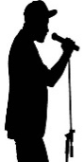

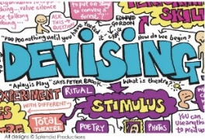
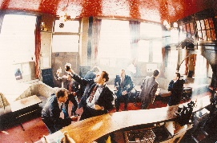

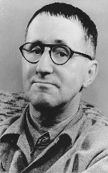



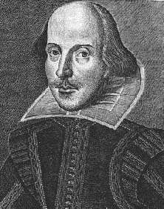
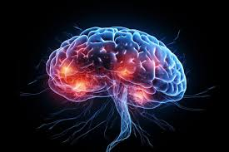

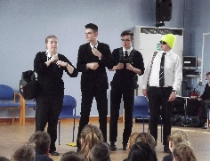

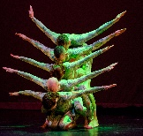


Examination Link
Knowledge
Subject Specific Skills
Underlined = Recall and deeper development of earlier skills / knowledge
Drama Learning Journey
Characterisation
Vocal Skills
Physical Skills
Mark Wheeller
Verbatim Theatre
Playwrights intentions
Component Two
Assessment
Progression to next stage of learning:
A Level Drama & Theatre
BTEC Performing Arts Level 3
Performing Arts Colleges
Respond to a Brief
Skills and Techniques
Proxemics
Staging
Narration
Mime
Lighting
Sound
Practitioners intentions, Interrelationships
Set & Staging
Costume
Lighting
Sound
Question: How can you communicate effectively to an audience?– study of plays for monologues and group work
Question: Which practitioners work do you find most effective and why?
Component One
Assessment
Question: What are the roles and responsibilities in the theatre
Interrelationships
Exploring the
Performing Arts
Performance Styles
11
Devising
Drama
Characterisation
Vocal Skills
Physical Skills
AO4
Evaluate
The
process
Brecht, Stanislavski,
Lecoq, Artaud,
DV8
Question: What makes good theatre?
Students will explore a range of stimuli & use their knowledge of performance styles, genre & form to devise a piece of theatre
Question: Does
an actor
have to have experienced
the same
emotions as a
character to give
a believable performance
C1 Assess
Stylistic
qualities of
practitioners
Characterisation
Vocal Skills
Physical Skills
Direct Address
Narration, Multi Role
AO2 select and
Develop skills and
techniques
Style &
Genre
10
Blood Brothers
Emotion memory
Given circumstances
Hillsborough
Question: What are the different styles
And genres in performance? How are practitioners influenced by style
Playwrights intentions
Emotion memory
Given circumstances
Reading and developing a play
Question: What makes good theatre?
Students will explore a range of stimuli & use
their knowledge of drama skills & performance styles to devise a piece of
theatre
C1 Interrelationships between
Processes and skills
AO3 Apply
Skills and techniques
Social Media
Question: How can stage positions help the audience
Understand
Character
relationships?
Theatre
Through Time
Narration, Flashback, Crosscutting,
9
Respond to a
brief
Characterisation
Vocal Skills
Physical Skills
Duologues
Performance style, stock characters
Documentary drama
Verbatim theatre
Question: Should drama educate or entertain?
Exploring the true story of the disappearance of Dan Nolan – students explore the range of drama conventions & style of Verbatim Theatre
Staging
Question: What's in a name?
Character profiles and appropriate skills
AO3 Apply skills
And techniques
Duologues
Reading and developing a play
C2 Performance
Of existing
repertoire
Gizmo
Melodrama
Performance Styles
Question: Should drama help to retell the past?
Using historical facts to develop empathy, leading to a performance using physical theatres
Stanislavski and Naturalism
Soaps
Playwrights intentions
AO4 Evaluate
Development
process
AO1 Understand
How to respond
To a brief
Characterisation
Vocal Skills
Physical Skills
Playwrights intentions
Reading and developing a play
8 Basic actions
Ernie’s Incredible
Illucinations
Time Travel
8
AO2
Select
Skills and techniques
Performance
Styles
Laban
Physical
Theatre
Question: What vocal and physical skills did you use for your performance and why did you make this decision? Students will understand the importance of creative decisions
Narration, Flashback
Crosscutting, mime,
Voice of conscience
Vocal and Physical
skills
AO2
Select
And develop
skills
8 Basic actions
Performance Styles
Characterisation
Vocal Skills
Physical Skills
Advanced Skills
Intro to Drama
7
Ghost
Stories
Ensemble work
Storytelling
Verbatim
AO3
Apply
Skills
And
Techniques
Status, performance style
Question: What are the benefits of using
Vocal and physical skills in performance? - Students develop their physical acting skills by exploring Ghost stories
Narration
Flashback
Croscutting
Voice of conscience
Characterisation
Vocal Skills
Physical Skills
Mime
AO2 Select and develop skills

